Slide 1
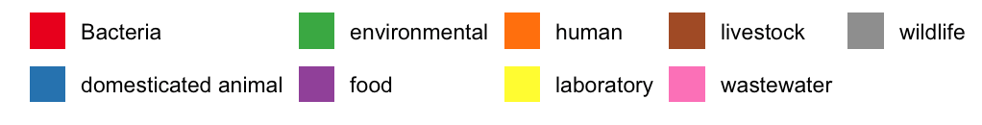
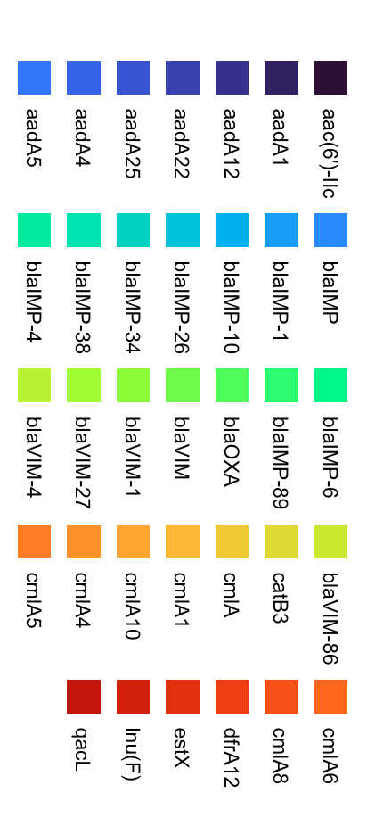
A
C
D
B
E
Notes:
Dimensions for the bar plots are aligning them horizontally with patchwork 1/1/1 width space, pasting the legends at the bottom, and save pdf 13 x 10 inches
Dimensions for the heatmap completely forgot but it was around that too
000759835.1

Slide 2
A
B

Slide 3
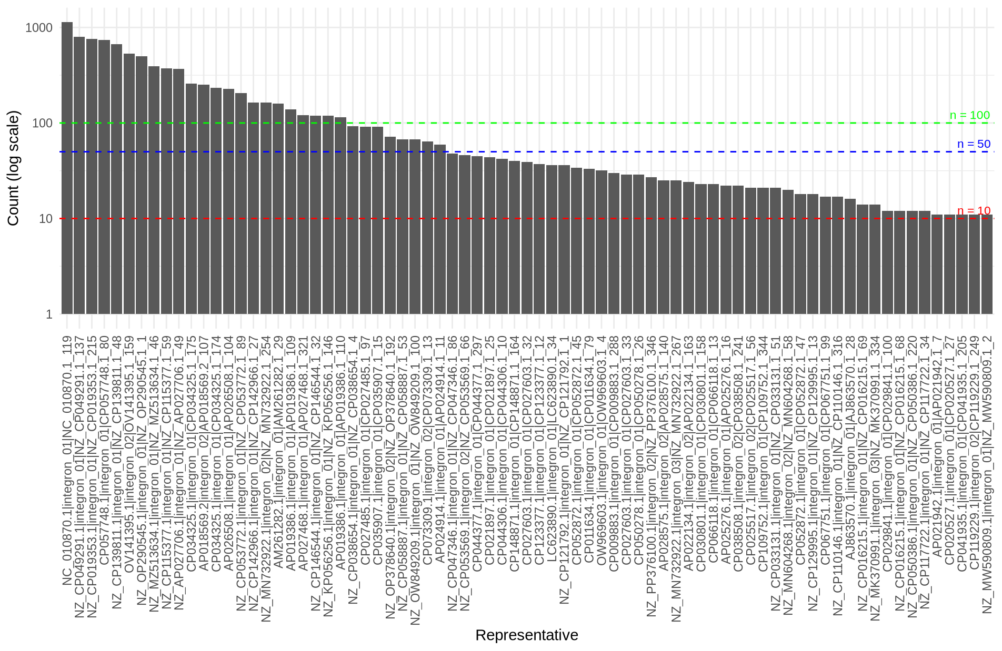

Slide 4
